Slide 1
SC1015:
MINI PROJECT
Company Bankruptcy Prediction
Group: 7
Ng Yuen Herng
Tan Wei Yin
Pearlina Tan Qinlin
Notes:
Hi we are group 7 from B128 and here with me is Wei Yin and Yuen Herng. This is our SC1015 mini project about company bankruptcy prediction.

Slide 2
TABLE OF CONTENTS
01
02
03
Problem
Formulation
Data Extraction
EDA
04
05
06
Machine Learning
Statistical Inference
Conclusion
Problem statement & Dataset
How we extracted and cleaned the data
Data-driven insights that we found
K-NN, Random Forest, SVM, XGBoost
Information presentation
To sum up the presentation
Notes:
This is our table of contents. We will first start of with problem formulation, then data extraction on how we extracted and cleaned our data, after which we will move on to the EDA. Then we will be talking about machine learning and statistical inference. Then we will end of our presentation with the conclusion

Slide 3

01 Problem Formulation
Notes:
First, we will be giving some background on our motivation to start this project and the problem that we faced

Slide 4


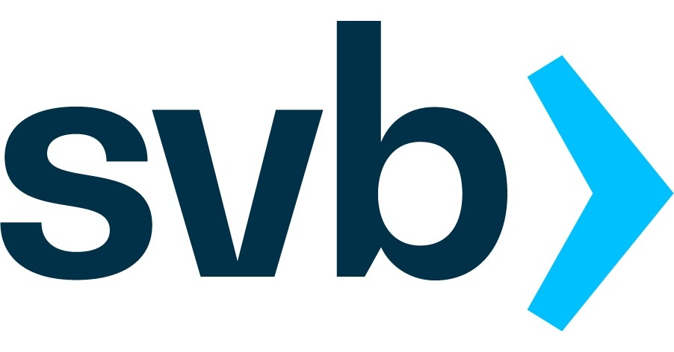
Collapse of companies
01 Problem Formulation
Sam Bankman-Fried’s cryptocurrency exchange FTX collapsed over 10 days in November 2022
crashed within 48 hours after spooked depositors rushed to withdraw their money.
Notes:
With the collapse of companies like FTX, which is one of the world's largest cryptocurrency exchanges who did not have sufficient assets in reserve to meet the customer demand, it collapsed over 10 days in 2022. Also, svb which crashed within 48 hours led to great damage whereby small banks lost a total of at least $108 billion. Thus, we wondered whether we would be able to predict whether a company would go bankrupt based on their statistics.

Slide 5
What are the factors that causes a company to go bankrupt and what's the best model to predict whether a company will go bankrupt
01 Problem Formulation
—PROBLEM STATEMENT
Notes:
Hence, this led to us forming our real-life problem. We are curious about what are the factors that can cause a company to go bankrupt and what’s the best model to predict whether a company will go bankrupt.

Slide 6

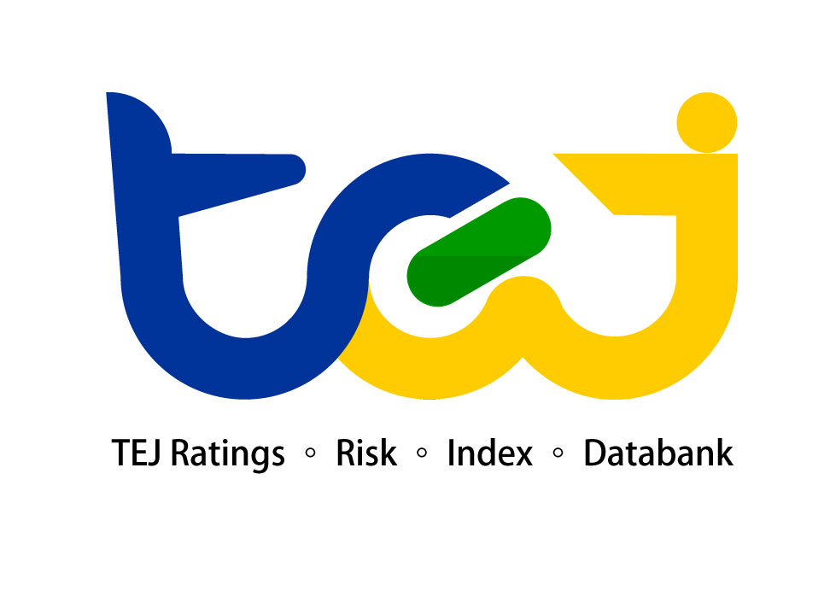
DATASET:
01 Problem Formulation
From the Taiwan Economic Journal from 1999 to 2009.
Notes:
Our data set is from the taiwan economic journal from 1999 to 2009 which was published on Kaggle. The bankruptcy was based on the business regulations of the Taiwan Stock Exchange.

Slide 7
02
Data Extraction
Notes:
We will move on with data extraction

Slide 8
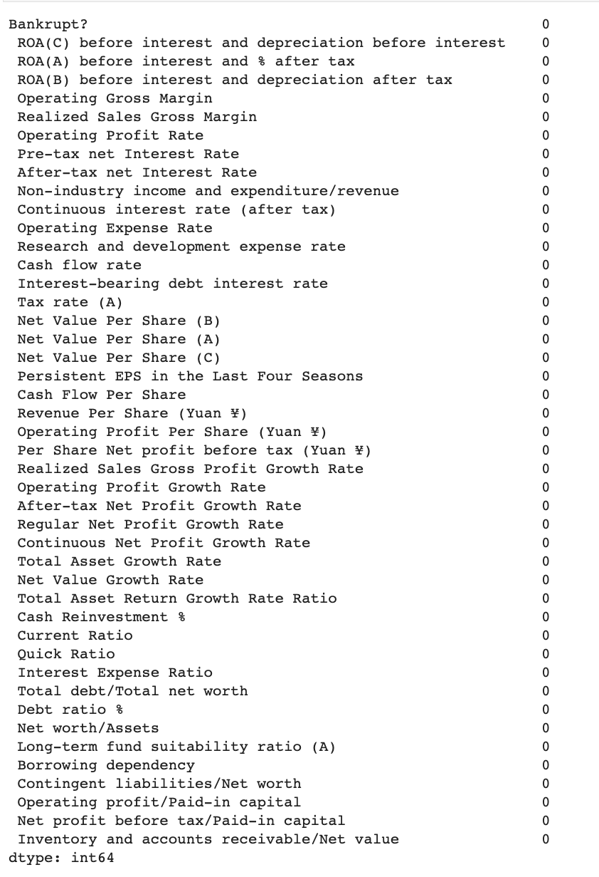
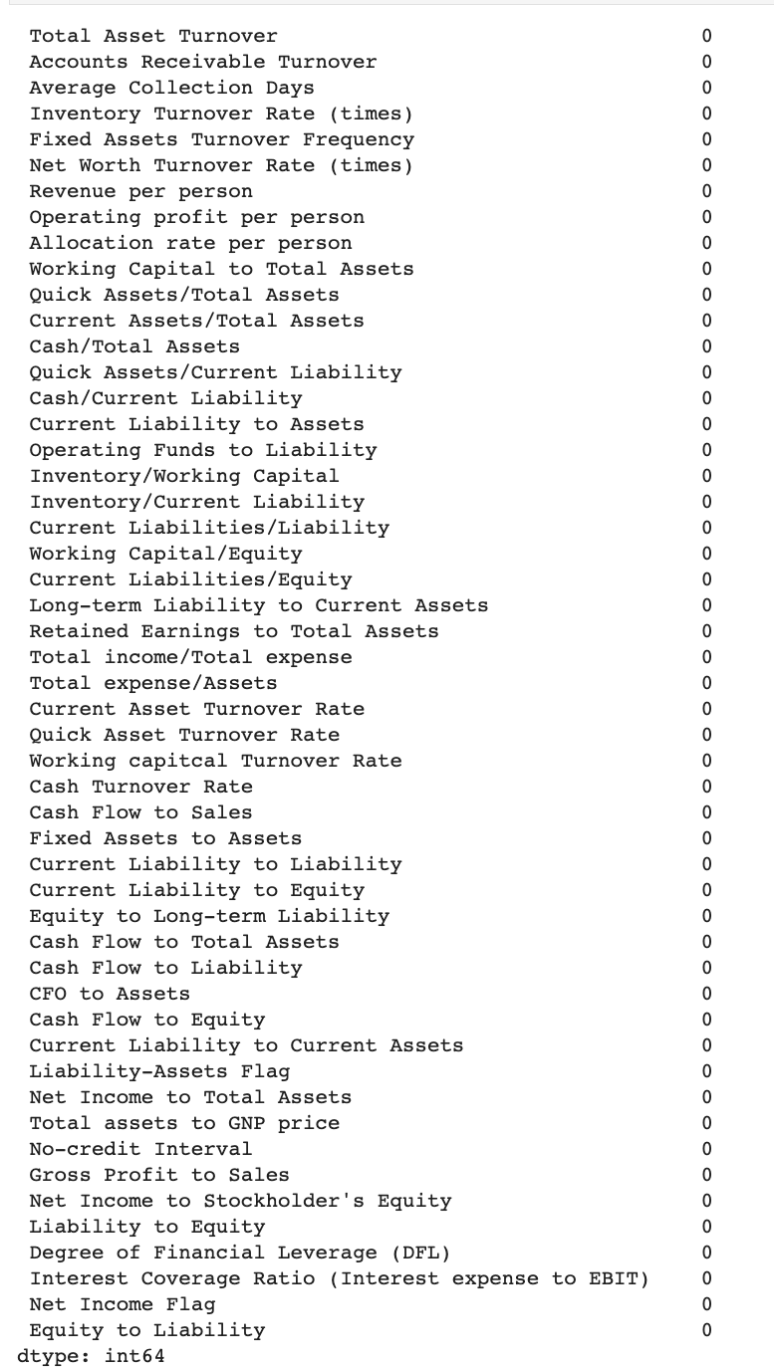
Checking for null values
02 Data Extraction
Notes:
In our code, we found out that the data has no NULL values

Slide 9
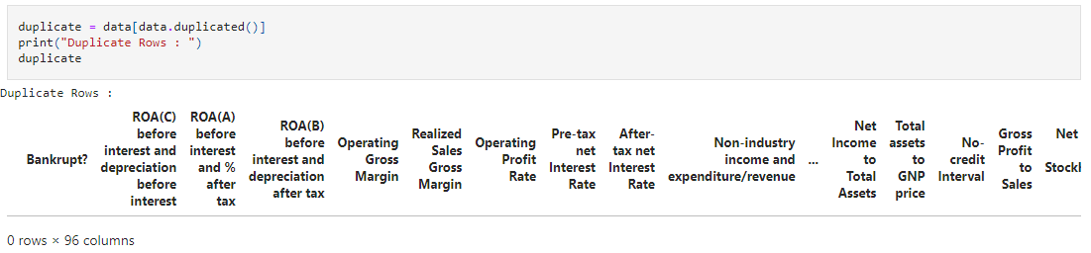

Checking for duplicate rows
02 Data Extraction
Notes:
We also checked for any duplicate rows which would provide inaccurate data, but fortunately there were none.

Slide 10
03 Exploratory Data Analysis
Notes:
Now i will move on the the exploratory data analysis

Slide 11
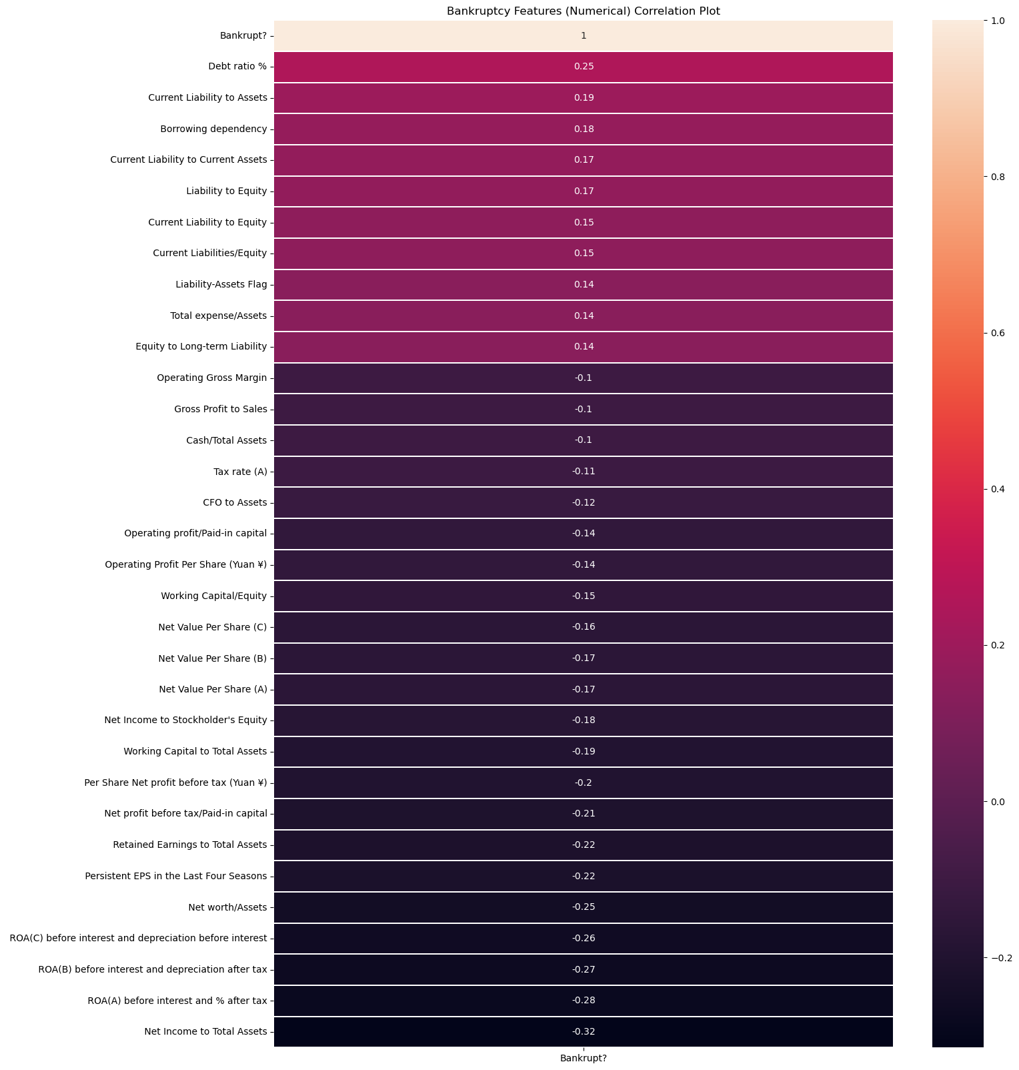
BASIC ANALYSIS (NUMERICAL)
03 Exploratory Data Analysis
Notes:
In our subsequent data analysis, we plotted a heatmap to check the correlation matrix of any features with a correlation coefficient above 0.1. Taking note that Net Income to Total Assets has the highest correlation matrix, we plot it and the bankruptcy on the following graph.

Slide 12
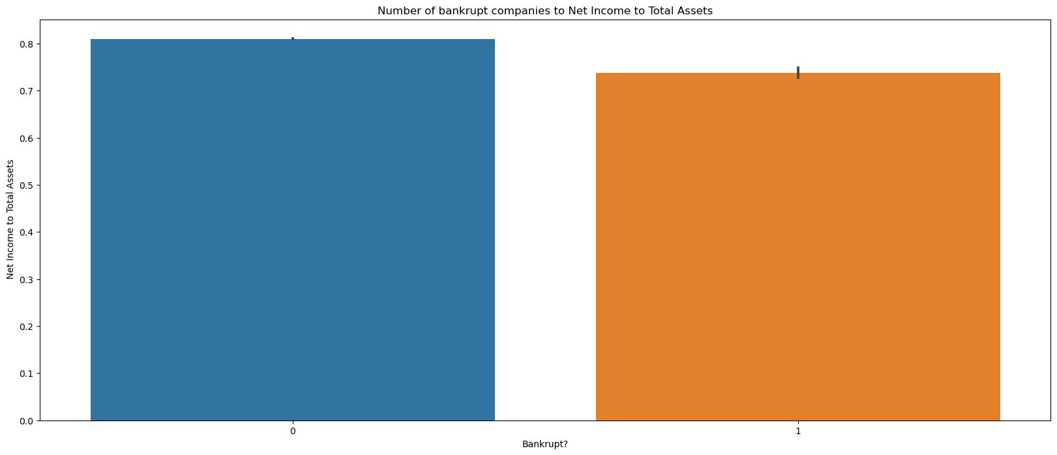
Bankruptcies to Net Income to Total Assets
03 Exploratory Data Analysis
Might be due to having a similar distribution
Notes:
At first glance, it seems that the net income to total assets doesn’t matter that much to whether a company will go bankrupt or not. However, since we know that our data is a classification problem, it could be because the distribution of data points are similar, which might explain why the number of values is roughly the same

Slide 13
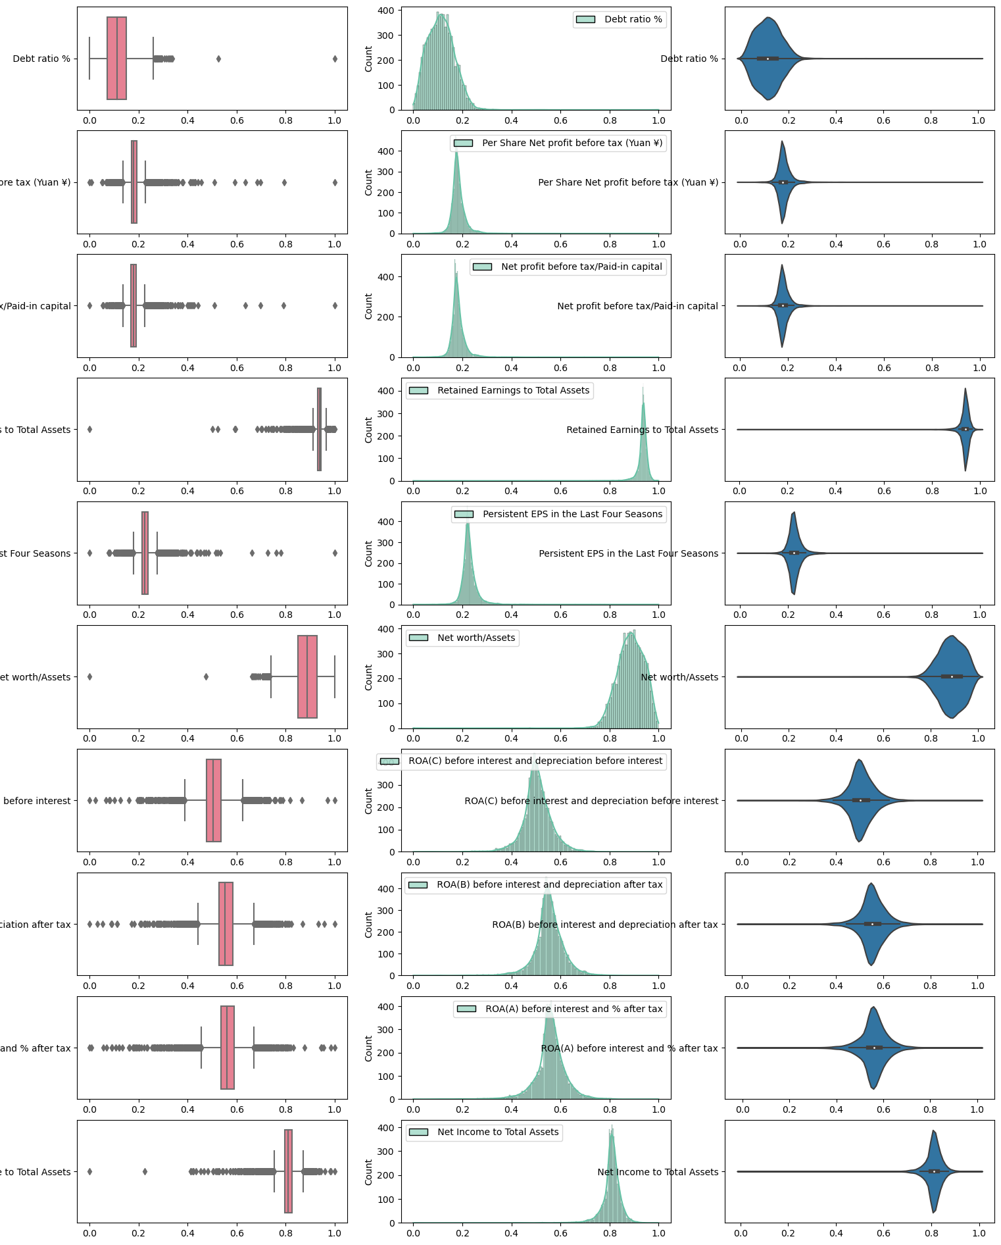
Checking for anomalies
03 Exploratory Data Analysis
Debt ratio %
Per Share Net profit before tax (Yuan ¥)
Net profit before tax/Paid-in capital
Retained Earnings to Total Assets
The outliers are due to the nature of the dataset, hence we should not remove them.
Persistent EPS in the Last Four Seasons
Net Worth / Assets
ROA(C) Before interest and depreciation before tax
ROA(B) Before interest and depreciation after tax
ROA(A) Before interest and % after tax
Net Income to Total Assets
Notes:
We choose the top 10 features with the correlation coefficient higher than 0.2. Next, we check for anomalies. Although there are some anomalies, we concluded that the anomalies are because they are a natural occurrence of our dataset. Also, we take note that there is some skewness in the data

Slide 14
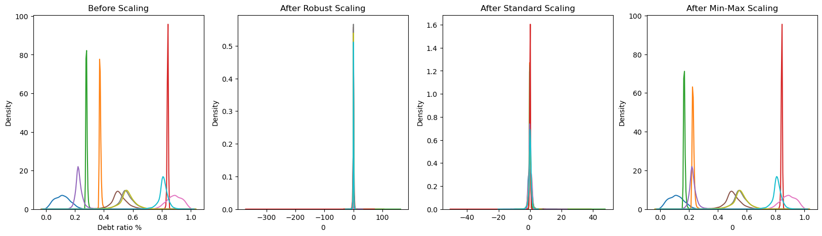
Feature Scaling
03 Exploratory Data Analysis
Very skewed
Notes:
Next, we looked at the impact of uneven range of independent variables. As we can see in the first graph, it is quite unbalanced, so we perform feature scaling to standardize the range. After trying 3 forms of feature scaling, we concluded that robust scaling works the best, since mix max is not effective, and after standard scaling still has some spread at the bottom of the curve.

Slide 15
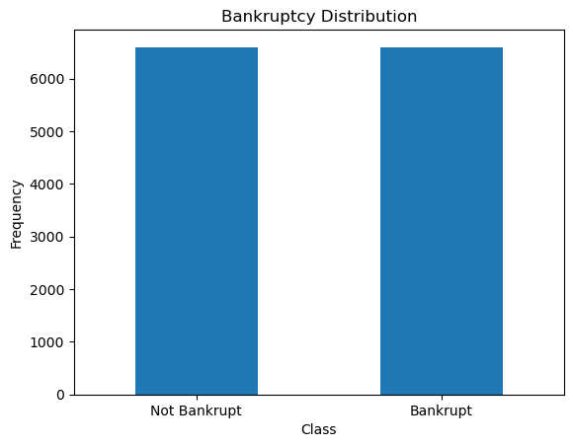
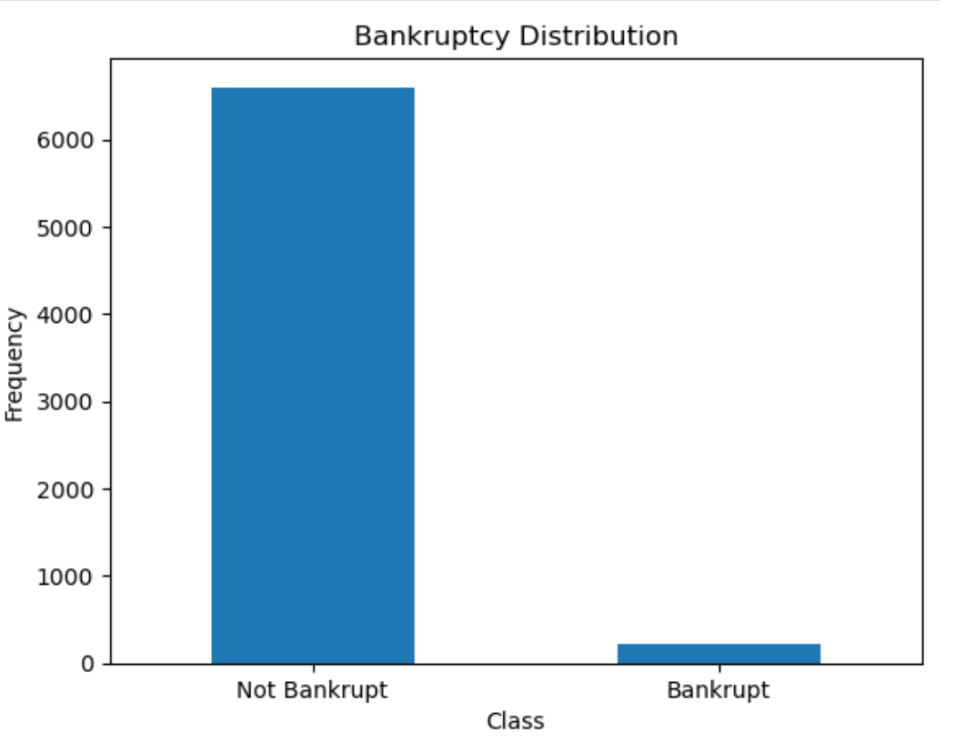
Imbalanced Data
After SMOTE …
03 Exploratory Data Analysis
Notes:
Next, we realized that there is a huge class imbalance, which makes sense because companies would not be very likely to go bankrupt, so we try and fix it using SMOTE. Looking at the data, it looks like the class imbalance has been resolved. So next, we move onto our models.

Slide 16

04 MACHINE LEARNING
K-Nearest Neighbors
RANDOM FOREST
SVM
XGBOOST

Slide 17
Splitting Dataset
Random split into train and test set
Measure of accuracy
F1 Score
Classification Accuracy
04 Machine Learning
Notes:
Since our problem is a classifying problem, we will be using models suitable for classification. Namely, K-Nearest Neighbours, Random Forest Classification, SVM, XGBoost

Slide 18

K-Nearest Neighbors
(K-NN)
04 Machine Learning
It is one of the simplest classification algorithms in which a new data point is classified based on similarity in the specific group of neighboring data points.
Notes:
What KNN?
It is one of the simplest classification algorithms in which a new data point is classified based on similarity in the specific group of neighboring data points.
Why KNN? KNN can capture non-linear decision boundaries, making it effective for datasets that have complex relationships between features. As you can see, the correlation coefficients between the features and the target variable are not close to 1 or -1. It suggests that the relationship between the features and the target variable may be nonlinear.

Slide 19
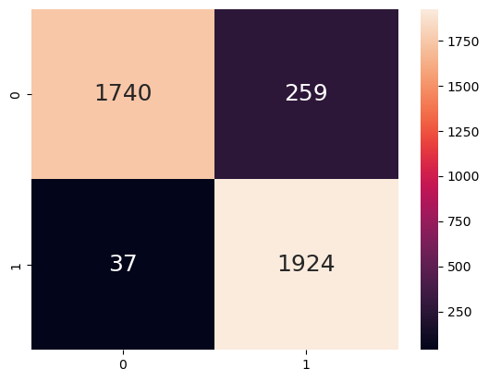
KNN Confusion matrix
04 Machine Learning
Classification Accuracy: 92.5%
TPR: 98.1%
FPR: 12.9%
KNN TEST F1 Score: 92.9%

Slide 20
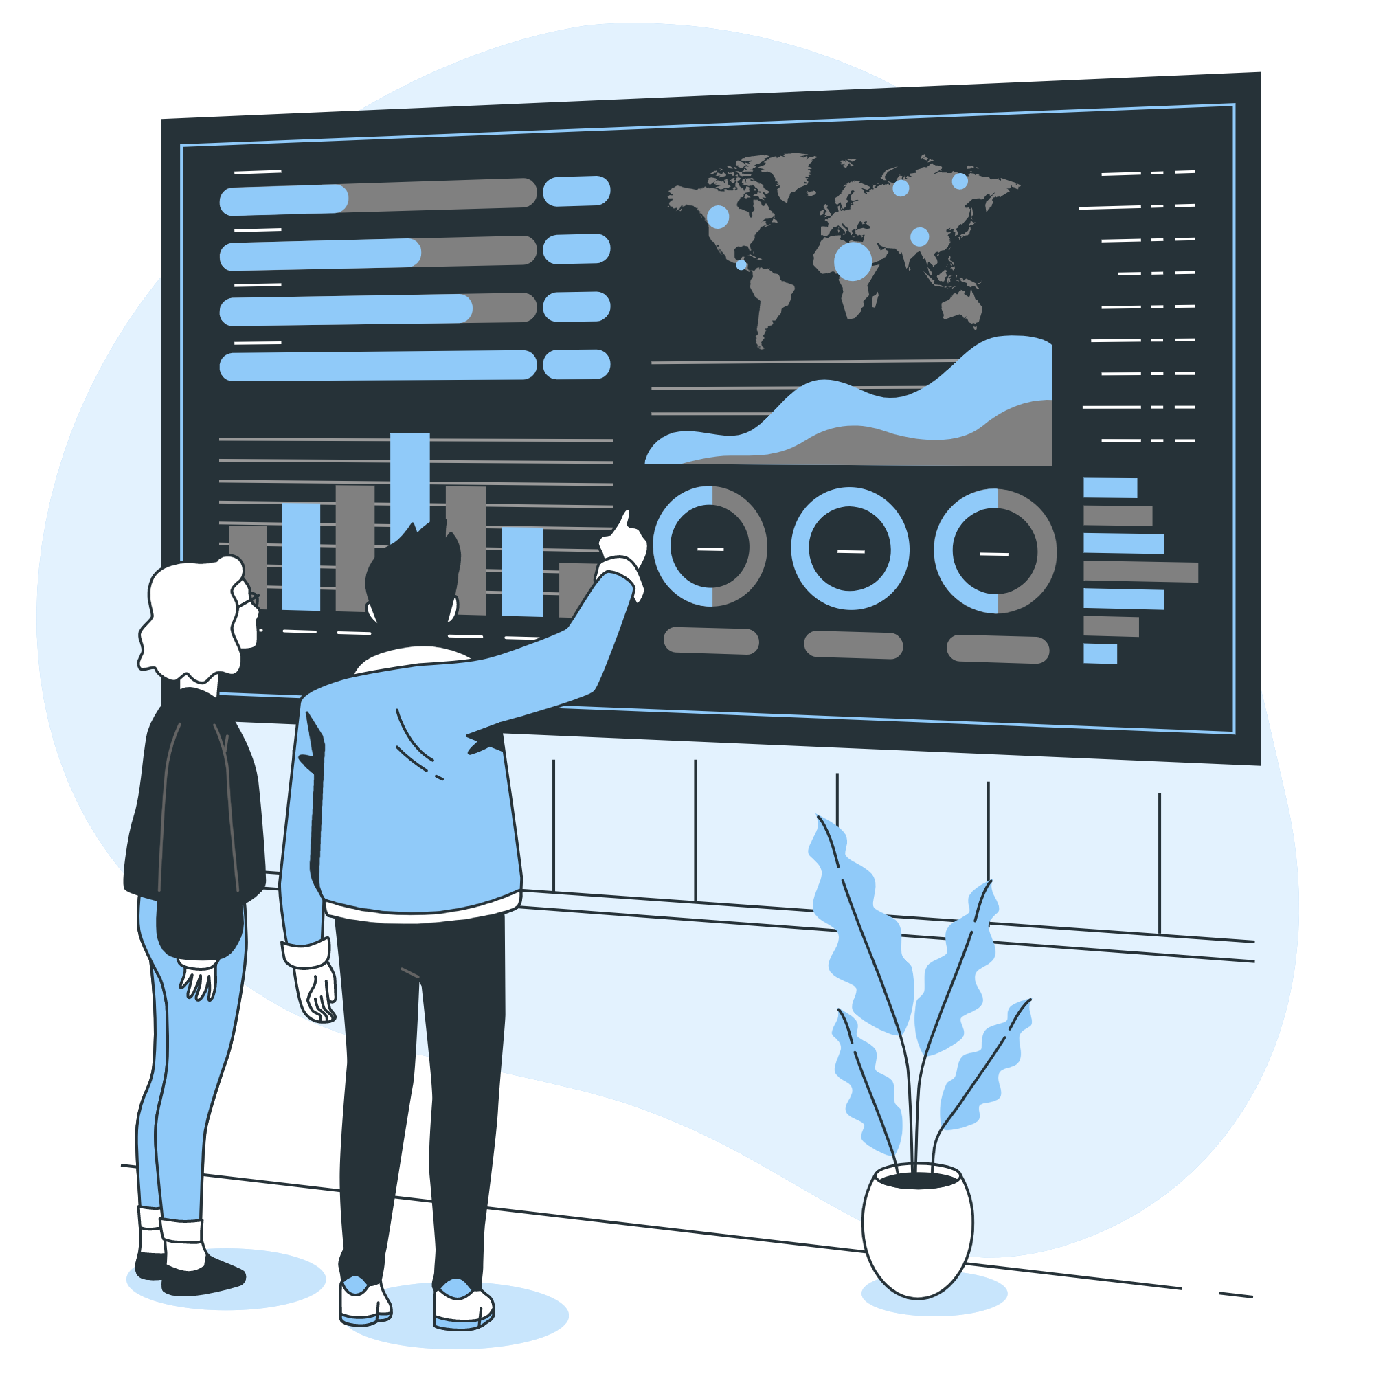
Random Forest Classification
04 Machine Learning
It is a commonly-used machine learning algorithm which combines the output of multiple decision trees to reach a single result.
Notes:
What is Random Forest?
Random forests is an ensemble learning method for classification, regression and other tasks that operates by constructing a multitude of decision trees at training time. For classification tasks, the output of the random forest is the class selected by most trees. For regression tasks, the mean or average prediction of the individual trees is returned.Random decision forests correct for decision trees' habit of overfitting to their training set.Random forests generally outperform decision trees, but their accuracy is lower than gradient boosted trees. However, data characteristics can affect their performance.
Why Random Forest?
Random Forest has been shown to have high accuracy in binary classification tasks, especially when compared to other classification algorithms.

Slide 21
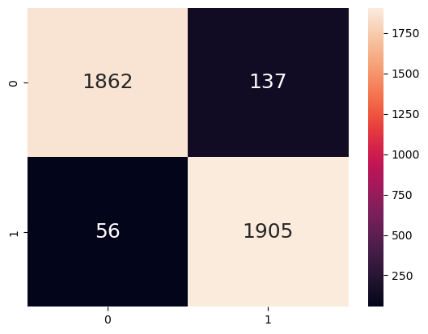
Random Forest Confusion matrix
04 Machine Learning
Classification Accuracy: 95.1%
(Higher than the previous model)
TPR: 97.1%
FPR: 6.8%
RANDOM FOREST TEST F1 Score: 95.2%
(Higher than the previous model)

Slide 22

Support Vector
Machines (SVM)
04 Machine Learning
It is a popular supervised learning algorithm in machine learning that is commonly used for classification and regression analysis.
Notes:
What is SVM?
Support Vector Machines (SVM) is a popular supervised learning algorithm in machine learning that is commonly used for classification and regression analysis. SVM tries to find the best possible decision boundary that can separate the data into different classes. It does this by identifying the support vectors, which are the data points closest to the decision boundary.
Why SVM?
SVM is particularly effective for datasets with a moderate number of samples, where the tradeoff between complexity and generalization is important.

Slide 23
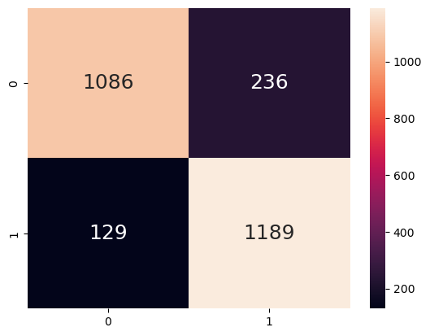
SVM Confusion matrix
04 Machine Learning
Classification Accuracy: 86.2%
(Lowest of all the models)
TPR: 90.2%
FPR: 17.9%
SVM TEST F1 Score: 86.7%
(Lowest of all the models)

Slide 24

XGBoost (Extreme Gradient Boosting)
04 Machine Learning
It is designed to optimize performance and speed in tree ensemble learning algorithms. It uses a combination of gradient boosting and regularization techniques to prevent overfitting and improve model accuracy.
Notes:
What is XGBoost?
XGBoost (Extreme Gradient Boosting) is a popular gradient boosting framework that is designed to optimize performance and speed in tree ensemble learning algorithms. It uses a combination of gradient boosting and regularization techniques to prevent overfitting and improve model accuracy. XGBoost has become a popular choice for machine learning competitions and is widely used in industry for its performance and scalability.
Why XGBoost?
XGBoost is known for its speed and efficiency
XGBoost is designed to be highly parallelizable and can be trained on large datasets quickly, making it well-suited for big data applications. Additionally, XGBoost has been shown to be effective for a wide range of machine learning tasks, including classification, regression, and ranking.

Slide 25

XGBoost Confusion matrix
04 Machine Learning
Classification Accuracy: 94.9%
TPR: 97.4%
FPR: 7.6%
XGBoost TEST F1 Score: 95.0%

Slide 26

F1 SCORE
KNN TEST F1 Score: 92.9%
RANDOM FOREST TEST F1 Score: 95.2%
SVM TEST F1 Score: 86.7%
XGBoost TEST F1 Score: 95.0%
Notes:
Random Forest test has the highest F1 score among the four model.

Slide 27
05 Statistical inference
Information presentation

Slide 28
Insights
Why our models are chosen
Comparing results across all models
05 Statistical Inference
Appropriateness against our existing data set
Accuracy and ability to achieve our goal
Able to capture non-linear decision boundaries
The most important feature in determining is Borrowing Dependency, contrary to what we had thought when calculating correlation coefficients
Random Forest is the best model to predict whether a company will go bankrupt or not, according to both ROC and F1 score metrics.
Notes:
Models can capture non-linear decision boundaries, making it effective for datasets that have complex relationships between features. As you can see, the correlation coefficients between the features and the target variable are not close to 1 or -1. It suggests that the relationship between the features and the target variable may be nonlinear.

Slide 29
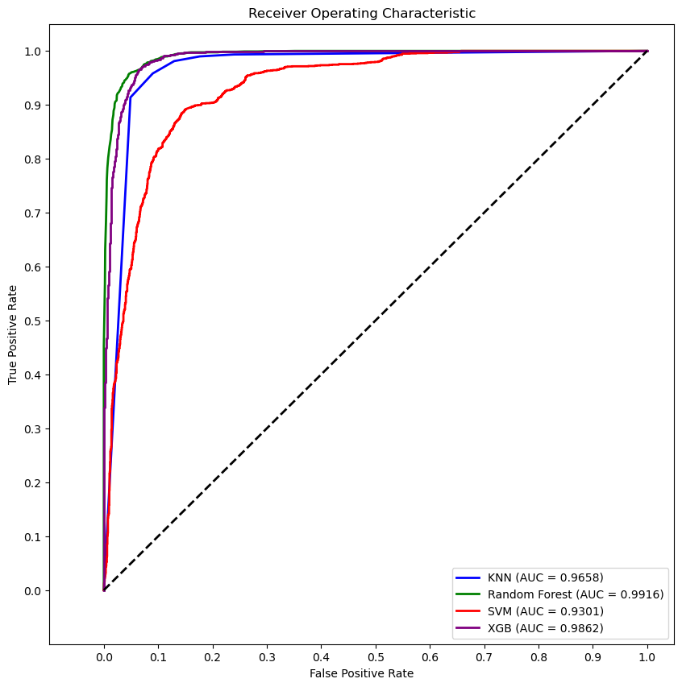
ROC curve
Notes:
Random Forest Classifier has the highest AUC Score, which is in line with our F1 score.

Slide 30
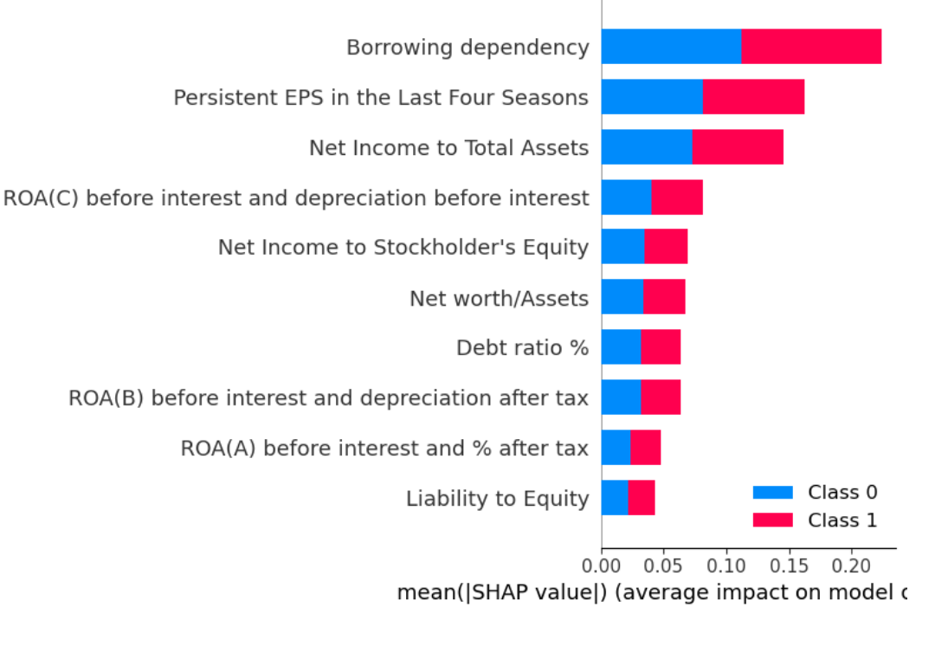
SHAP
Notes:
For further analysis, we use SHAP on the Random Forest Model to visualize what the most important features are. So in contrary to our EDA, Borrowing dependency actually seems to be the biggest determinant in predicting whether a company will go bankrupt. Next, we take a look at the top 3 features and how they relate to Bankruptcy

Slide 31
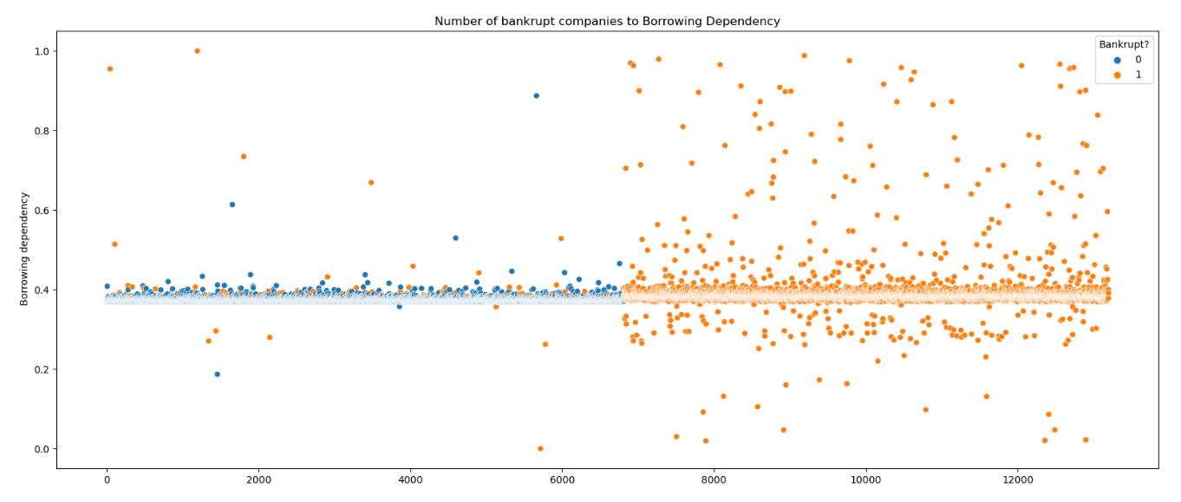
No. 1: Borrowing Dependency
Notes:
For Borrowing Dependency, it seems like the orange part of the graph is more concentrated, and has more data points where the borrowing dependency is higher. So, we can conclude that having a higher borrowing dependency is one of the factors of becoming bankrupt.

Slide 32
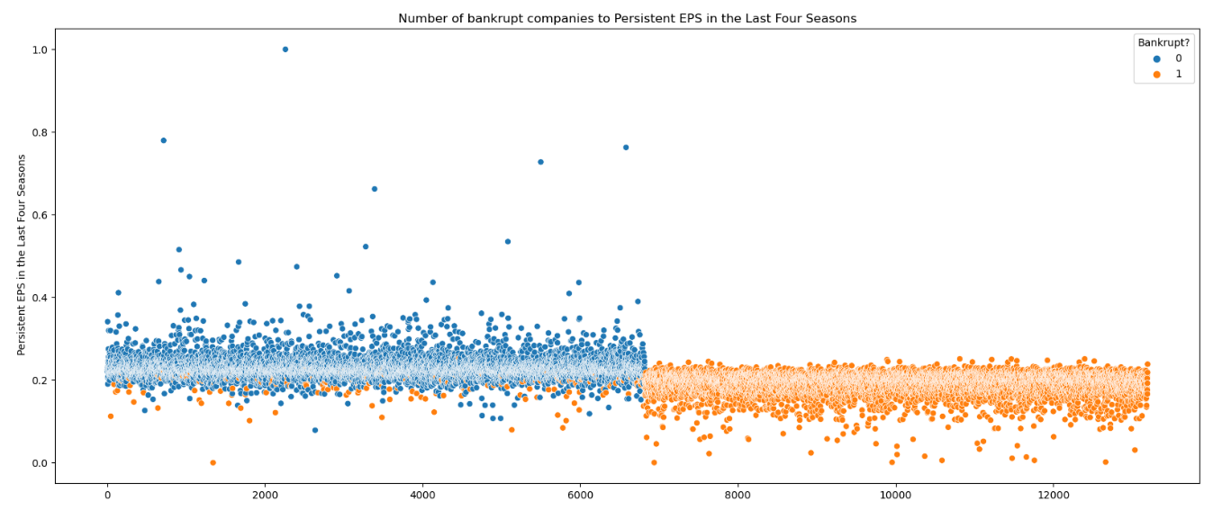
No. 2: Persistent EPS in the Last 4 Seasons
Notes:
According to the graph, it is clear that higher EPS would mean that the company is less likely to go bankrupt.

Slide 33
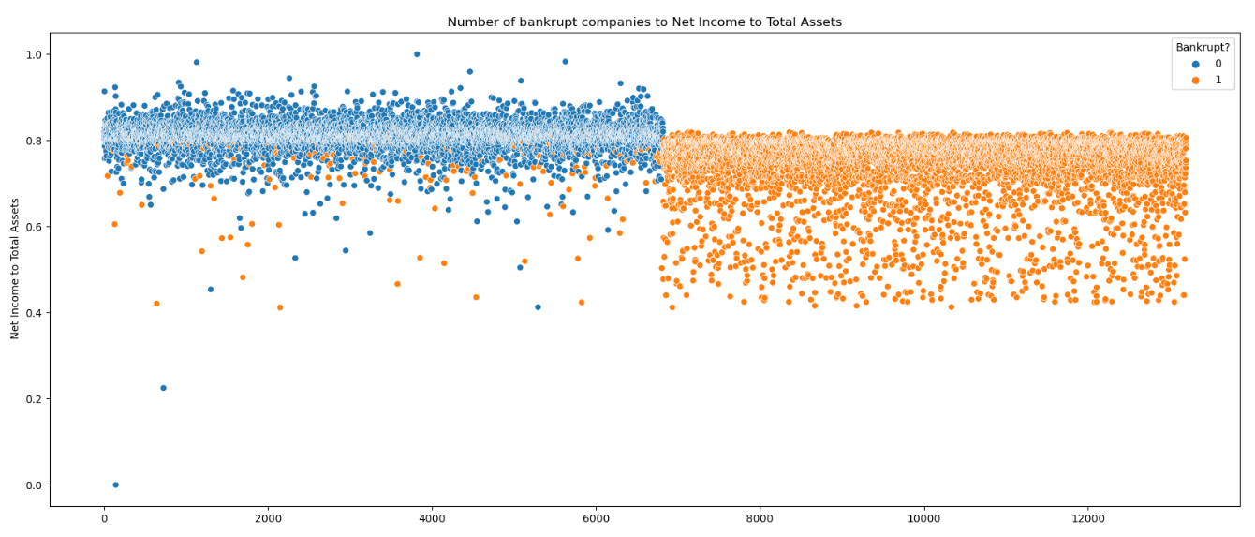
No. 3: Net Income to Total Assets
Notes:
The graph clearly shows orange data points being lower to the bottom, and the blue data points being closer to the top. So, we can conclude that having a higher net income to total assets prevents bankruptcy.

Slide 34

Conclusion
To sum up our presentation
Notes:
Using SMOTE to balance our data improved model performance, especially on the minority class
Random Forest did exceptionally well in predicting bankruptcy.

Slide 35

Outcome of the project
Using our Machine Learning model, shareholders can:
Predict the risk of bankruptcy for their company using various features.
Evaluate the effectiveness of different strategies and interventions aimed at reducing the risk of bankruptcy.

Slide 36

Conclusion
Based on our model, the top 3 things to look out for to check whether a company would go bankrupt is:
High borrowing dependency
Insufficient funds
Unsustainable growth
Low EPS
Overvalued company
Spending more than their worth
Limited growth potential
Lower profitability
Low Net Income to Total Assets
Asset impairment
Devaluation in assets
Poor asset utilization
Notes:
A high borrowing dependency would mean that the company does not actually have sufficient funds to support their expansion, and this leads to unsustainable growth.
A low EPS means the company is overvalued, and they’re spending more than they’re worth. This could lead to limited growth potential as well as lower profitability.
Having a low Net Income to Total Assets ratio could mean that the company could have some issues in asset impairment, due to a devaluation in their assets, or poor asset utilization.

Slide 37

Thank you!

Slide 38
RESOURCES
https://slidesgo.com/theme/investors-social-media
<a href="https://storyset.com/business">Business illustrations by Storyset</a>
<a href="https://storyset.com/data">Data illustrations by Storyset</a>
<a href="https://storyset.com/people">People illustrations by Storyset</a>
<a href="https://storyset.com/work">Work illustrations by Storyset</a>
<a href="https://storyset.com/business">Business illustrations by Storyset</a>

